Slide 1
Generative Models of Music
Computational Music Creativity, SMC (2021/22)
Prepared by Behzad Haki, February 2022

Slide 2


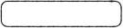
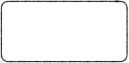
Tentative Plan
Part 1
Part 2(A)
Part 2(B)
Tasks and Models
Intro to RNNs
Seq2Seq
Intro to NN
GRU vs LSTM
Seq2Seq-VAE
Theory Sessions
VAE
Examples
Examples
Pd-Python Communication
Using a trained model in pd-python
(Maybe) Training a VAE
Lab Sessions

Slide 3
Plan for Today
Part 1
Tasks and Models
1. We’ll go over some existing models, not in detail, just for reference
Theory Session
Intro to NN
2. We’ll talk about Neural Networks, cover some basic concepts
VAE
3. We’ll talk about Auto-encoders and Variational Auto-encoders
Pd-Python Communication
Lab Sessions

Slide 4

Tasks in Generative AI Music
Tasks and Models
Intro to NN
VAE
Short-term Generation
Long-term Generation
Humanization
Style Transformation
Sequence Complexity Variation
Conditional Generation
Continuation
Multi-Instrument Orchestration
Sequence Interpolation
Notes:
Short and long term generation: generating small snippets or generating long (and consistent) pieces
Conditional generation deals with generating content given a set of specification (e.g. given a genre, or given a sample of another composition)
Continuation deals with continuing a primer sequence. That is, if you have the beginning of a piece, you want the model to further develop it by generating content that is stylistically consistent
Humanizing models try to modify a score so as to add performance characteristics to it, that is to say, make it as if it was performed by a human
Orchestration deals with generating multi-voice scores that are well interlocked with one another
Style transformation, is basically transforming a piece from a given style into another style
Sequence interpolation is to fill in patterns between two given starting and ending patterns in a ‘meaningful’ way
And finally, sequence complexity variation, deals with adding (infilling extra parts) or removing parts without changing the essence of a piece

Slide 5
Models in Generative AI Music
Tasks and Models
Intro to NN
VAE
ARCHITECTURE
Seq2Seq
GANs
Transformers
Multi-Scale VQ-VAE
MODEL
MusicVAE
GrooVAE
MuseGAN
LakhNess
Jukebox
Music Transformer
16-bar Generation, Continuation and Interpolation
Short-term Drum Generation, Humanization, Completion, Sequence Interpolation
4-Bar Multi-instrument Generation (Conditional and Unconditional)
Piano Generation, Continuation
Multi-instrument Generation, Continuation
Long-term Multi-instrument Generation
TASKS ACCOMPLISHED
Symbolic
Work well for shorter sequences
More successful for longer sequences
Audio
Notes:
Some of the more successful models employing deep learning for Music generation. (A bit outdated yet still relevant review)

Slide 6

Models in Generative AI Music
Tasks and Models
Intro to NN
VAE
ARCHITECTURE
Seq2Seq
GANs
Transformers
Multi-Scale VQ-VAE
MODEL
MusicVAE
GrooVAE
MuseGAN
LakhNess
Jukebox
Music Transformer
16-bar Generation, Continuation and Interpolation
Short-term Drum Generation, Humanization, Completion, Sequence Interpolation
4-Bar Multi-instrument Generation (Conditional and Unconditional)
Piano Generation, Continuation
Multi-instrument Generation, Continuation
Long-term Multi-instrument Generation
TASKS ACCOMPLISHED
Symbolic
Work well for shorter sequences
More successful for longer sequences
Audio
We’ll be focusing on these in the next two lectures

Slide 7


Models in Generative AI Music
Tasks and Models
Intro to NN
VAE
ARCHITECTURE
Seq2Seq
GANs
Transformers
Multi-Scale VQ-VAE
MODEL
MusicVAE
GrooVAE
MuseGAN
LakhNess
Jukebox
Music Transformer
16-bar Generation, Continuation and Interpolation
Short-term Drum Generation, Humanization, Completion, Sequence Interpolation
4-Bar Multi-instrument Generation (Conditional and Unconditional)
Piano Generation, Continuation
Multi-instrument Generation, Continuation
Long-term Multi-instrument Generation
TASKS ACCOMPLISHED
Symbolic
Work well for shorter sequences
More successful for longer sequences
Audio
Will not be able to cover these in detail in this course
Notes:
I may briefly talk about transformers if time allows. At least, what we’ve been using them for
For now, let’s look at some of these models without worrying about how they actually work.

Slide 8
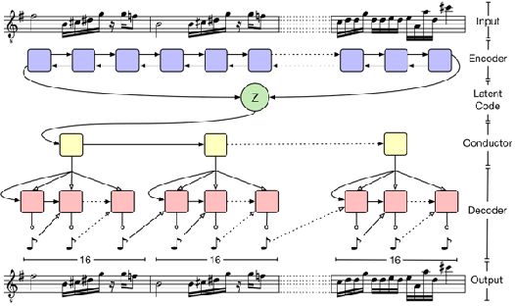
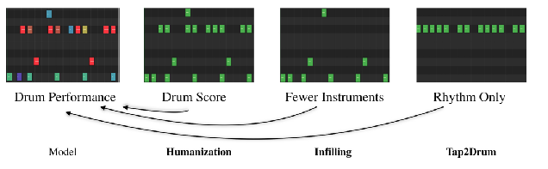
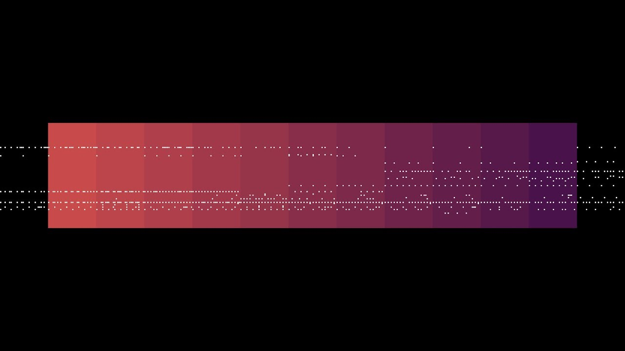
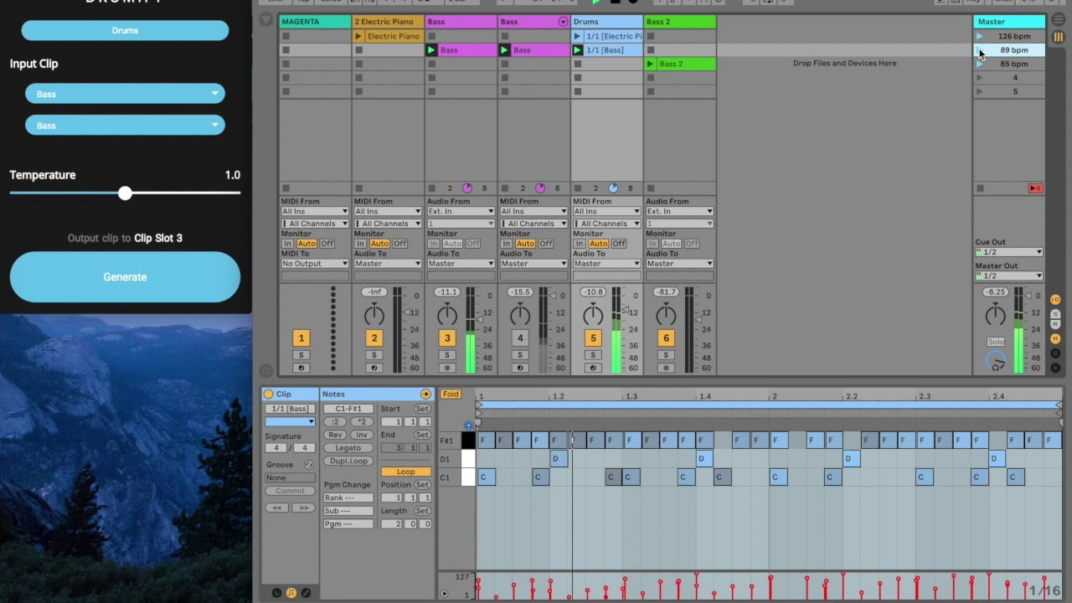
Sequence-to-Sequence Models
Tasks and Models
Intro to NN
VAE
Gillick, Jon, et al. "Learning to groove with inverse sequence transformations." International Conference on Machine Learning. PMLR, 2019.
Source: https://magenta.tensorflow.org/music-vae
https://youtube.com/watch?v=OsxP4lFp76I
https://youtube.com/watch?v=x2YLmXzovDo

Slide 9
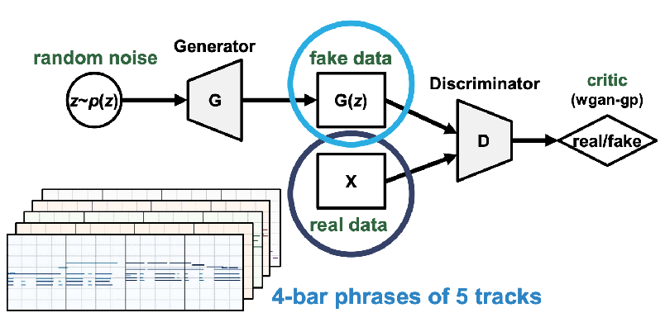

MuseGAN
Tasks and Models
Intro to NN
VAE
Image from https://salu133445.github.io/musegan/pdf/musegan-aaai2018-slides.pdf
https://youtube.com/watch?v=0aN9tKNCYxM

Slide 10
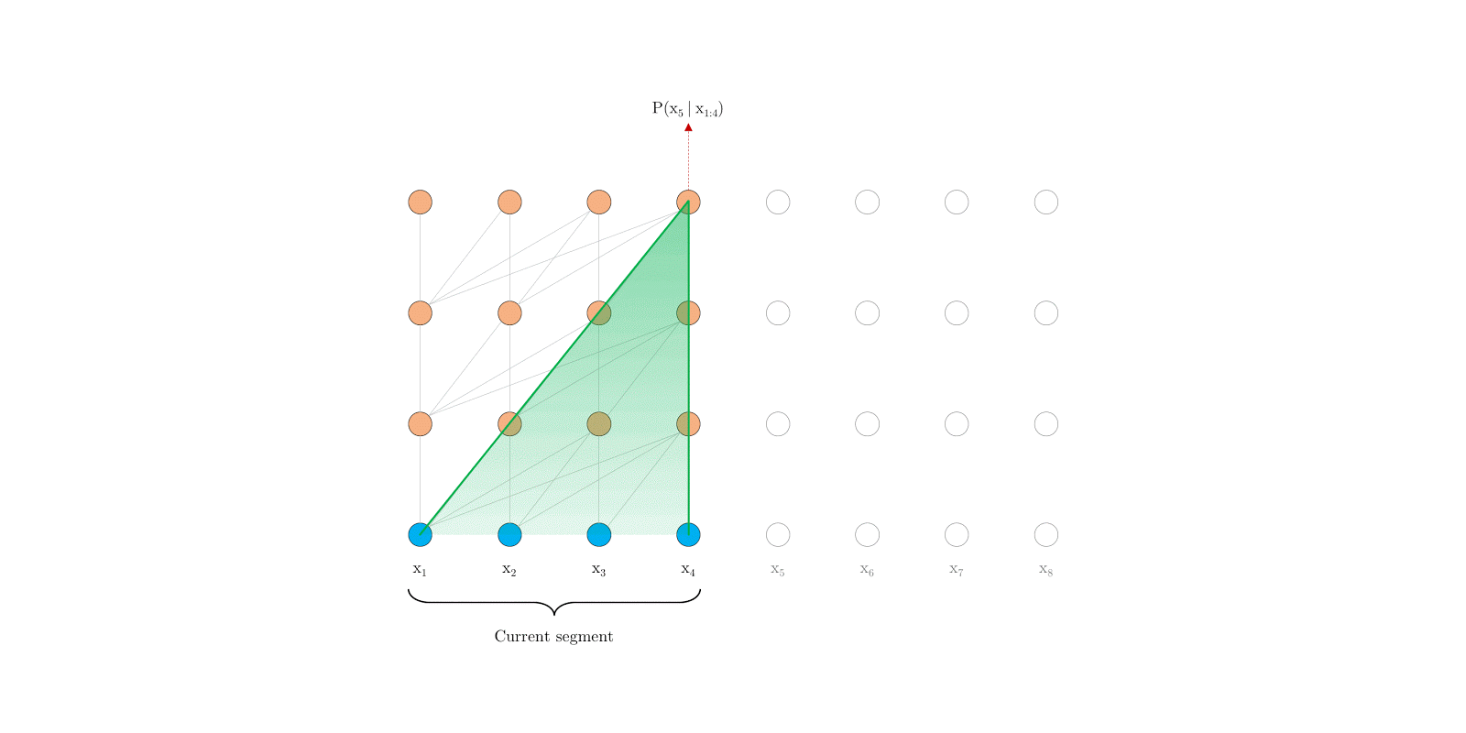
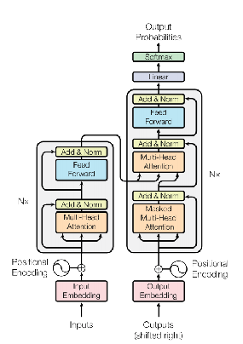
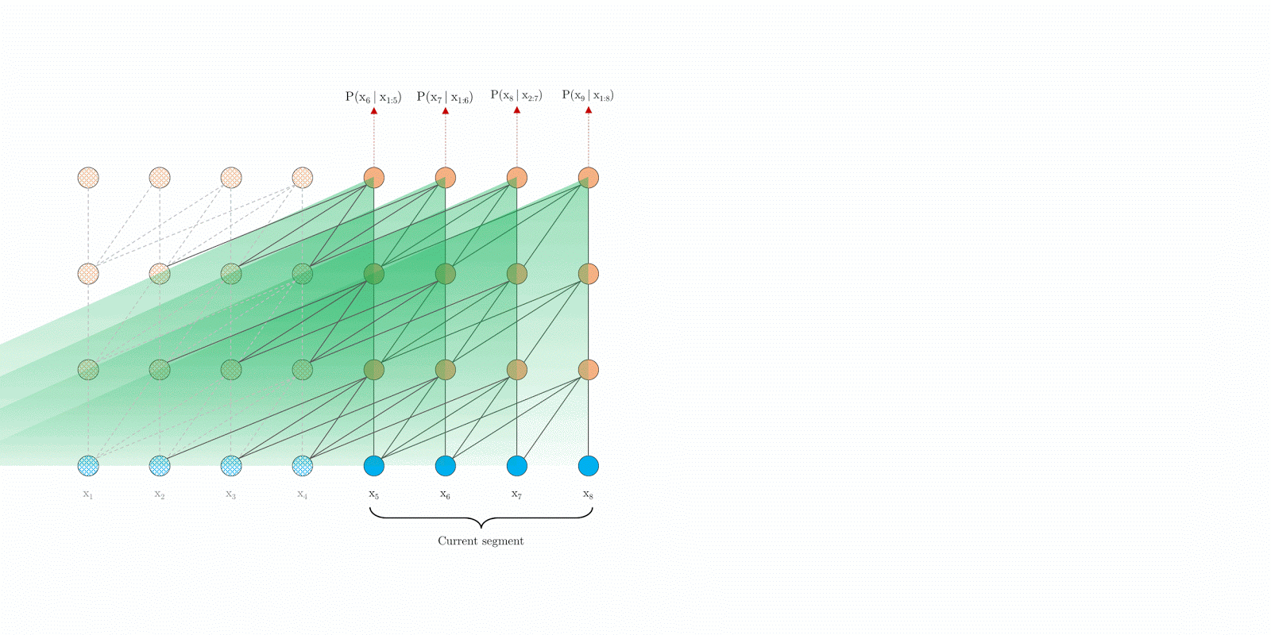
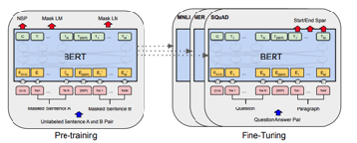
Transformers
Tasks and Models
Intro to NN
VAE
Vanilla Transformer
Source: https://ai.googleblog.com/2019/01/transformer-xl-unleashing-potential-of.html
Vanilla Transformer
Source: Vaswani, Ashish, et al. "Attention is all you need." arXiv preprintarXiv:1706.03762 (2017).
BERT: Bidirectional Encoder Representation for Language Understanding
Devlin, Jacob, et al. "Bert: Pre-training of deep bidirectional transformers for language understanding." arXiv preprint arXiv:1810.04805 (2018).
Transformer-XL
Source: https://ai.googleblog.com/2019/01/transformer-xl-unleashing-potential-of.html

Slide 11
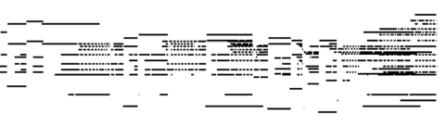
Music Transformer [1]
Tasks and Models
Intro to NN
VAE
Video from https://magenta.tensorflow.org/assets/music_transformer/motifs_visualization.mp4
[1] Reference: https://magenta.tensorflow.org/music-transformer

Slide 12
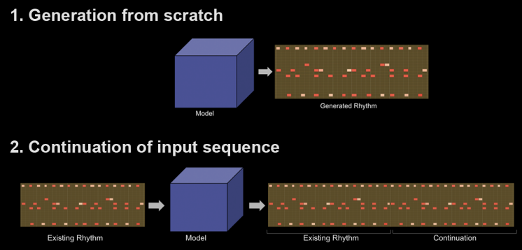

Transformer Neural Networks for Automated Rhythm Generation
(Master Thesis 2020 by Thomas Nuttall)
Tasks and Models
Intro to NN
VAE

Slide 13
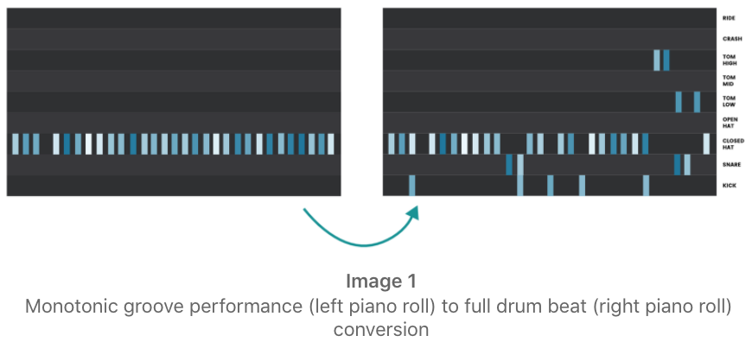
Transformer Architecture for Generating Short Drum Loops Given a Performed Monotonic Groove
(Master Thesis 2021 by Marina Nieto)
Tasks and Models
Intro to NN
VAE
Groove
Drum Pattern Generated
By the Transformer Model

Slide 14
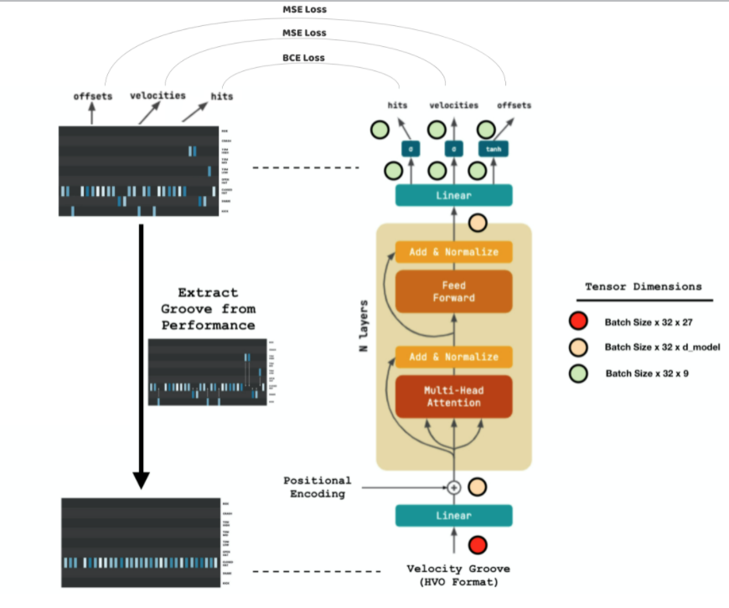
Transformer Architecture for Generating Short Drum Loops Given a Performed Monotonic Groove
(Master Thesis 2021 by Marina Nieto)
Tasks and Models
Intro to NN
VAE

Slide 15
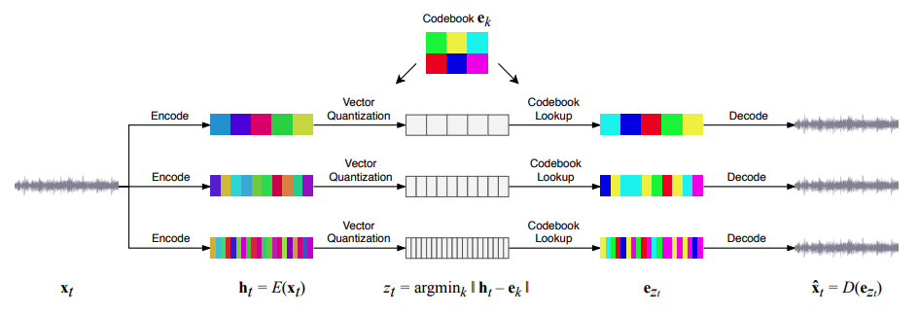
JukeBox [2]
Tasks and Models
Intro to NN
VAE
Image from [2]
Samples Here: https://jukebox.openai.com/?song=787640146
[2] Dhariwal, Prafulla, et al. "Jukebox: A generative model for music." arXiv preprint arXiv:2005.00341 (2020).

Slide 16
Introduction to Neural Nets
Tasks and Models
Intro to NN
VAE
A Music Generation Perspective

Slide 17

What Are Neural Nets?
Tasks and Models
Intro to NN
VAE
Why do we use them?
Imagine you have a system which transforms some input data $X$ to some output $Y$.
If we know $H$, then for any new data points, we can calculate $Y$ by passing $X$
However, in reality, we usually have observations of $X$ and $Y$, using which, we want to actually figure out what the transformation is. This is quite useful, because if we can figure out what $H$ is based on our observations, then we can predict the value for Y given an input value outside of our observations.
Known
Known
H
$$X$$
$$Y=H(x)$$
Partially Known
H
Partially Known
$$X$$
$$Y=H(x)$$

Slide 18
What Are Neural Nets?
Tasks and Models
Intro to NN
VAE
Why do we use them?
A few notes:
If we only partially know X and Y, the best we can do is to come up with an approximation of H such that it works “well” on the available observations
No matter how much data we’ve observed, we can not be certain that we’ve observed all possible combinations of X and Y. More data may allow us to be more confident in our approximation of H, but it does not allow us to be fully confident that we know everything about the behaviour of H.
We can not be certain if Y is only dependant on X
We can not be sure that H is a deterministic transformation
Partially Known
H
Partially Known
$$X$$
$$Y=H(x)$$

Slide 19

What Are Neural Nets?
Tasks and Models
Intro to NN
VAE
Why do we use them?
Partially Known
$$H$$
Partially Known
$$X$$
$$Y=H(x)$$
In the absence of full knowledge about $X$, $Y$ and $H$,
All we can do is to come up with the best approximation of $H$,
given all available observations
Objective: Based on observations of $X$ and $Y$, find a reasonable approximation for $H$
How can we do this?

Slide 20
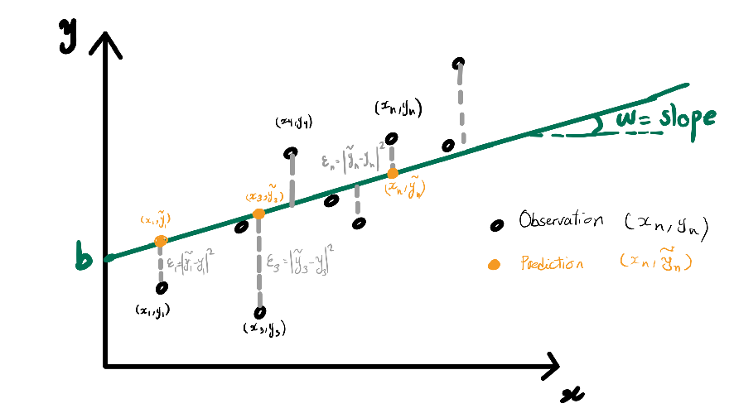
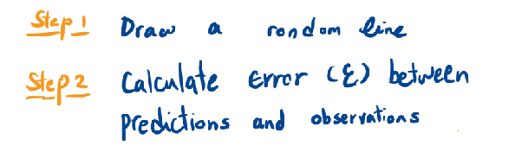
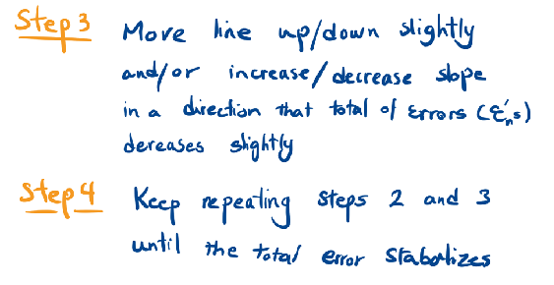
What Are Neural Nets?
Tasks and Models
Intro to NN
VAE
How can we approximate the X to Y transformation?

Slide 21

What Are Neural Nets?
Tasks and Models
Intro to NN
VAE
How can we approximate the X to Y transformation?
H
$$X$$
$$\overset{˜}{Y}=H(x)$$
$$J_{w,b}(H)=1/m\overset{m}{\underset{i=1}{∑}}(y_{i}-\overset{˜}{y})^{2}=1/m\overset{m}{\underset{i=1}{∑}}(y_{i}-H(x_{i}))^{2}$$
Initialize/Randomize parameters of $H$
Find $J_{w,b}(H)$
( distance/loss between the actual observation ($Y$) and the prediction ($\overset{˜}{Y}$) )
Slightly adjust the parameters of H such that the distance/loss reduces slightly
Keep Repeating Until Distance/Loss Stabilizes

Slide 22
What Are Neural Nets?
Tasks and Models
Intro to NN
VAE
How can we approximate the X to Y transformation?
H
$$X$$
$$\overset{˜}{Y}=H(x)$$
$$J_{θ}(H)$$
$$\frac{δJ_{θ}(H)}{δθ}$$
Moving along gradient, increases loss, so move the parameters in the opposite direction of the gradient
$$θ$$
$$J_{w,b}(H)=1/m\overset{m}{\underset{i=1}{∑}}(y_{i}-\overset{˜}{y})^{2}=1/m\overset{m}{\underset{i=1}{∑}}(y_{i}-H(x_{i}))^{2}$$
We can do this by inspecting the gradient of
$J_{w,b}(H)$
Initialize/Randomize parameters of $H$
Find $J_{w,b}(H)$
( distance/loss between the actual observation ($Y$) and the prediction ($\overset{˜}{Y}$) )
Slightly adjust the parameters of H such that the distance/loss reduces slightly
Keep Repeating Until Distance/Loss Stabilizes

Slide 23
What Are Neural Nets?
Tasks and Models
Intro to NN
VAE
How can we approximate the X to Y transformation?
But what if we’re dealing with high dimensional data
And much more complex transformations?
Turns out Neural Networks are quite useful for such cases, because
NNs can be used to created highly complex non-linear operations

Slide 24
What Are Neural Nets?
Tasks and Models
Intro to NN
VAE
How can we approximate the X to Y transformation?
But what if we’re dealing with high dimensional data
And much more complex transformations?
Turns out Neural Networks are quite useful for such cases, because
NNs can be used to created highly complex non-linear operations.
The following still applies
Initialize/Randomize parameters of $H$
Find $J_{w,b}(H)$
( distance/loss between the actual observation ($Y$) and the prediction ($\overset{˜}{Y}$) )
Slightly adjust the parameters of H such that the distance/loss reduces slightly
Keep Repeating Until Distance/Loss Stabilizes

Slide 25
Neural Networks
Tasks and Models
Intro to NN
VAE
A Single Neuron
+1
b (bias)
$$x_{1}$$
$$w_{1}$$
$$y=Wx+b=\left[\begin{matrix}w_{1} & w_{2} & w_{3} & w_{4}\end{matrix}\right]\left[\begin{aligned}x_{1} \\ x_{2} \\ x_{3} \\ x_{4}\end{aligned}\right]+b$$
$$x_{2}$$
$$w_{2}$$
$$∑$$
$$w_{3}$$
$$x_{3}$$
$$w_{4}$$
$$x_{4}$$

Slide 26
Neural Networks
Tasks and Models
Intro to NN
VAE
Multiple Neurons
+1
$$x_{1}$$
$$∑$$
$$y_{1}$$
$$b_{2}$$
$$x_{2}$$
$$w_{2,1}$$
$$\left[\begin{aligned}y_{1} \\ y_{2} \\ y_{3}\end{aligned}\right]=Wx+b=\left[\begin{matrix}w_{1,1} & w_{1,2} & w_{1,3} & w_{1,4} \\ w_{2,1} & w_{2,2} & w_{2,3} & w_{2,4} \\ w_{3,1} & w_{3,2} & w_{3,3} & w_{3,4}\end{matrix}\right]\left[\begin{aligned}x_{1} \\ x_{2} \\ x_{3} \\ x_{4}\end{aligned}\right]+\left[\begin{aligned}b_{1} \\ b_{2} \\ b_{3}\end{aligned}\right]$$
$$w_{2,2}$$
$$∑$$
$$w_{2,3}$$
$$y_{2}$$
$$x_{3}$$
$$w_{2,4}$$
$$x_{4}$$
$$∑$$
$$y_{3}$$

Slide 27

Neural Networks
Tasks and Models
Intro to NN
VAE
Multiple Neurons
Activation Function, used to:
Add Nonlinearity,
Activate/Deactivate neuron,
Specify the type of output (probability vs. Scalar)
+1
$$x_{1}$$
$$∑$$
$$AF$$
$$y_{1}$$
$$b_{2}$$
$$x_{2}$$
$$w_{2,1}$$
$$w_{2,2}$$
$$\left[\begin{aligned}y_{1} \\ y_{2} \\ y_{3}\end{aligned}\right]=AF(Wx+b)=AF(\left[\begin{matrix}w_{1,1} & w_{1,2} & w_{1,3} & w_{1,4} \\ w_{2,1} & w_{2,2} & w_{2,3} & w_{2,4} \\ w_{3,1} & w_{3,2} & w_{3,3} & w_{3,4}\end{matrix}\right]\left[\begin{aligned}x_{1} \\ x_{2} \\ x_{3} \\ x_{4}\end{aligned}\right]+\left[\begin{aligned}b_{1} \\ b_{2} \\ b_{3}\end{aligned}\right])$$
$$w_{2,3}$$
$$∑$$
$$AF$$
$$y_{2}$$
$$x_{3}$$
$$w_{2,4}$$
$$x_{4}$$
$$∑$$
$$AF$$
$$y_{3}$$

Slide 28


Neural Networks
Tasks and Models
Intro to NN
VAE
Multiple Neurons
+1
$$x_{1}$$
$$∑$$
$$AF$$
$$y_{1}$$
$$b_{2}$$
$$x_{2}$$
$$w_{2,1}$$
$$w_{2,2}$$
$$∑$$
$$AF$$
$$w_{2,3}$$
$$y_{2}$$
$$x_{3}$$
$$w_{2,4}$$
Reference: https://medium.com/@shrutijadon10104776/survey-on-activation-functions-for-deep-learning-9689331ba092
$$x_{4}$$
$$∑$$
$$AF$$
$$y_{3}$$
Notes:
There are a number of reasons to use AFs:
Add non-linearity to the transformation
A biological inspiration —> not every neuron is active at all times. You want only certain neutrons to be active for certain inputs
You want your outputs to be bounded within a specific range! Or you want your outputs to represent different data types! For example, sigmoid is used for probability estimations

Slide 29
Neural Networks
Tasks and Models
Intro to NN
VAE
Multiple Layers (Different Ways of Visualization)
Detailed Representation
Input Layer
Hidden Layer #1
Hidden Layer #2
Output Layer
+11
+11
+11
$$x_{1}$$
$$∑$$
$$AF$$
$$x_{2}$$
$$∑$$
$$AF$$
$$∑$$
$$AF$$
$$y_{1}$$
$$∑$$
$$AF$$
$$x_{3}$$
$$∑$$
$$AF$$
$$∑$$
$$AF$$
$$y_{2}$$
$$x_{4}$$
$$∑$$
$$AF$$
Simplified Representation
Abstract Representation
+11
+11
+11
$$x_{1}$$
$$x_{2}$$
$$y_{1}$$
$$x_{3}$$
$$y_{2}$$
$$x_{4}$$
Input Layer
Hidden Layer #1
Hidden Layer #2
Output Layer
Input Layer
Hidden Layer #1
Hidden Layer #2
Output Layer

Slide 30
Music Generation Using Feedforward Networks
Tasks and Models
Intro to NN
VAE
Example 1
Given a 1 bar drum sequence, predict the events at the next time-step
(16th note quantized, with uTiming, velocity and 4/4 meter)
$$Kick_{t=0}Active∈\{0,1\}$$
$$Kick_{t=0}Vel∈[0,1]$$
$$Kick_{t=0}μT∈[-0.5,0.5]$$
$$Snare_{t=0}Active∈\{0,1\}$$
$$Snare_{t=0}Vel∈[0,1]$$
$$Snare_{t=0}μT∈[-0.5,0.5]$$
$$Kick_{t=0}ProbabilityofActive∈(0,1)$$
$$Hat_{t=0}Active∈\{0,1\}$$
$$Hat_{t=0}Vel∈[0,1]$$
$$Kick_{t=0}Vel∈[0,1]$$
$$Hat_{t=0}μT∈[-0.5,0.5]$$
$$Kick_{t=0}μT∈[-0.5,0.5]$$
$$Snare_{t=0}ProbabilityofActive∈(0,1)$$
$$Snare_{t=0}Vel∈[0,1]$$
$$Kick_{t=15}Active∈\{0,1\}$$
$$Snare_{t=0}μT∈[-0.5,0.5]$$
$$Kick_{t=15}Vel∈[0,1]$$
$$Kick_{t=15}μT∈[-0.5,0.5]$$
$$Hat_{t=0}ProbabilityofActive∈(0,1)$$
$$Snare_{t=15}Active∈\{0,1\}$$
$$Snare_{t=15}Vel∈[0,1]$$
$$Hat_{t=0}Vel∈[0,1]$$
$$Snare_{t=15}μT∈[-0.5,0.5]$$
$$Hat_{t=0}μT∈[-0.5,0.5]$$
$$Hat_{t=15}Active∈\{0,1\}$$
$$Hat_{t=15}Vel∈[0,1]$$
$$Hat_{t=15}μT∈[-0.5,0.5]$$
$$=$$
$$∑$$
$$=$$
$$∑$$
$$Sigmoid$$
$$=$$
$$∑$$
$$tanh$$
$$=$$
$$ReLu$$
$$=$$
$$=$$

Slide 31
Music Generation Using Feedforward Networks
Tasks and Models
Intro to NN
VAE
Example 2
Predict a chord for a given 1 bar Melodic phrase
(16th note quantized, with uTiming, velocity and 4/4 meter)
$$C_{t=0}Active∈\{0,1\}$$
$$C\#_{t=0}Active∈\{0,1\}$$
One-Hot (Only one of these can be active)
$$A\#_{t=0}Active∈\{0,1\}$$
$$C_{t=0}Active∈\{0,1\}$$
$$B_{t=0}Active∈\{0,1\}$$
$$Vel_{t=0}∈[0,1]$$
$$C\#_{t=0}Active∈\{0,1\}$$
$$μT_{t=0}∈[-0.5,0.5]$$
$$C_{t=15}Active∈\{0,1\}$$
$$A\#_{t=0}Active∈\{0,1\}$$
$$C\#_{t=15}Active∈\{0,1\}$$
One-Hot (Only one of these can be active)
$$B_{t=0}Active∈\{0,1\}$$
$$A\#_{t=15}Active∈\{0,1\}$$
$$B_{t=15}Active∈\{0,1\}$$
$$Vel_{t=15}∈[0,1]$$
$$μT_{t=15}∈[-0.5,0.5]$$
$$=$$
$$∑$$
$$Sigmoid$$
$$=$$
$$=$$
$$∑$$
$$ReLu$$
$$=$$
Notes:
C maj —> C, E, G

Slide 32
Music Generation Using Feedforward Networks
Tasks and Models
Intro to NN
VAE
Example 3
Given a 1 bar Melodic phrase, predict the the next note
(16th note quantized, with uTiming, velocity and 4/4 meter)
$$C_{t=0}Active∈\{0,1\}$$
$$C\#_{t=0}Active∈\{0,1\}$$
One-Hot (Only one of these can be active)
$$A\#_{t=0}Active∈\{0,1\}$$
$$z_{0}$$
$$σ_{0}$$
$$ProbabilityofNextNote=C$$
$$B_{t=0}Active∈\{0,1\}$$
$$z_{1}$$
$$σ_{1}$$
$$Vel_{t=0}∈[0,1]$$
$$ProbabilityofNextNote=C\#$$
$$μT_{t=0}∈[-0.5,0.5]$$
$$σ(z_{i})=\frac{e^{z_{i}}}{\sum_{j=1}^{K}{e^{z_{j}}}}$$
Softmax Layer
$$\underset{i}{∑}σ(z_{i})=1σ(z_{i})∈[0,1]$$
$$C_{t=15}Active∈\{0,1\}$$
$$z_{10}$$
$$σ_{10}$$
$$ProbabilityofNextNote=A\#$$
$$C\#_{t=15}Active∈\{0,1\}$$
$$z_{11}$$
$$σ_{11}$$
One-Hot (Only one of these can be active)
$$ProbabilityofNextNote=B$$
$$Vel_{t=0}∈[0,1]$$
$$A\#_{t=15}Active∈\{0,1\}$$
$$μT_{t=0}∈[-0.5,0.5]$$
$$B_{t=15}Active∈\{0,1\}$$
$$Vel_{t=15}∈[0,1]$$
$$=$$
$$∑$$
$$Sigmoid$$
$$μT_{t=15}∈[-0.5,0.5]$$
$$=$$
$$=$$
$$∑$$
$$tanh$$
$$=$$
$$=$$
$$∑$$
$$ReLu$$
$$=$$

Slide 33
Music Generation Using Feedforward Networks
Tasks and Models
Intro to NN
VAE
Cost Functions
Remember the following example?
$$X$$
H
$$\overset{˜}{Y}=H(x)$$
$$J_{w,b}(H)=1/m\overset{m}{\underset{i=1}{∑}}(y_{i}-\overset{˜}{y})^{2}=1/m\overset{m}{\underset{i=1}{∑}}(y_{i}-H(x_{i}))^{2}$$
Initialize/Randomize parameters of $H$
Find $J_{w,b}(H)$
( distance/loss between the actual observation ($Y$) and the prediction ($\overset{˜}{Y}$) )
Slightly adjust the parameters of H such that the distance/loss reduces slightly
Keep Repeating Until Distance/Loss Stabilizes
$$J_{θ(w,b)}=CostFunction$$
The criterion used for evaluating the closeness of the predictions to a target
We use different cost (loss) functions for different cases

Slide 34
Music Generation Using Feedforward Networks
Tasks and Models
Intro to NN
VAE
Cost Functions
Task | Output Type | Target Encoding | Output Activations | Cost (loss)
Regression | Real | Real Values, or a subset of real values | Linear (Identity), ReLu, Sigmoid, Tanh | MSE (Mean Squared Error)
Classification | Binary | {0, 1} | Sigmoid | Binary cross-entropy
Classification | Multi-class Single Label | One-hot | Softmax | Categorical cross-entropy
Classification | Multi-class Multi-label | Many-hot | Sigmoid | Binary cross-entropy
Table from [1]
[1] Briot, Jean-Pierre, Gaëtan Hadjeres, and François Pachet. Deep learning techniques for music generation. Springer, 2020. Page 72

Slide 35
Music Generation Using Feedforward Networks
Tasks and Models
Intro to NN
VAE
Cost Functions (Binary Cross Entropy)
Task | Output Type | Target Encoding | Output Activations | Cost (loss)
Regression | Real | Real Values, or a subset of real values | Linear (Identity), ReLu, Sigmoid, Tanh | MSE (Mean Squared Error)
Classification | Binary | {0, 1} | Sigmoid | Binary cross-entropy
Classification | Multi-class Single Label | One-hot | Softmax | Categorical cross-entropy
Classification | Multi-class Multi-label | Many-hot | Sigmoid | Binary cross-entropy
Table from [1]
Monophonic Output (Example 1)
Multiple notes allowed to be played
This means that the probability of a note
occurring should be measured individually
Predictions
Actual Target
For the predictions, we’ll assume that probabilities above 0.5 mean an active note. Hence, the model is predicting that we have a Kick and Hat coming up while the real data (target) shows that in fact we should have a Kick and Snare coming up.
Let’s find how far are the predictions from the targets
It doesn’t make sense to find the euclidean distance between Actual targets and the predictions. Hence, we use a probabilistic criterion for the distance between predictions and the targets. In this case, we find the losses for kick, snare and hat predictions individually and then add them up. Each each individual loss can be calculated using Binary Cross Entropy Loss (BCE):
$BCE=-($$target_{i}$$log($$prediction_{i}$$)$+(1-$target_{i}$)$log($(1-$prediction_{i}$$)$)
$where$ $target_{i}$$∈\{0,1\}and$ $prediction_{i}$$∈(0,1)$
$$Kick_{t=0}Active$$
$$0.8$$
$$1$$
$$Kick_{t=0}Vel∈[0,1]$$
$$Kick_{t=0}μT∈[-0.5,0.5]$$
$$Snare_{t=0}Active$$
$$0.2$$
$$1$$
$$Snare_{t=0}Vel∈[0,1]$$
$$Snare_{t=0}μT∈[-0.5,0.5]$$
$$Hat_{t=0}Active$$
$$0.7$$
$$0$$
$$Hat_{t=0}Vel∈[0,1]$$
$$Hat_{t=0}μT∈[-0.5,0.5]$$
[1] Briot, Jean-Pierre, Gaëtan Hadjeres, and François Pachet. Deep learning techniques for music generation. Springer, 2020. Page 72

Slide 36
Music Generation Using Feedforward Networks
Tasks and Models
Intro to NN
VAE
Cost Functions (Mean Squared Error)
Task | Output Type | Target Encoding | Output Activations | Cost (loss)
Regression | Real | Real Values, or a subset of real values | Linear (Identity), ReLu, Sigmoid, Tanh | MSE (Mean Squared Error)
Classification | Binary | {0, 1} | Sigmoid | Binary cross-entropy
Classification | Multi-class Single Label | One-hot | Softmax | Categorical cross-entropy
Classification | Multi-class Multi-label | Many-hot | Sigmoid | Binary cross-entropy
Table from [1]
Real Valued Outputs (Example 1-3)
Velocity and Micro-Timings are real valued
predictions
$μT∈[-0.5,0.5]$, $Vel∈[0,1]$
This case is similar to the linear regression example we saw earlier
Let’s find how far are the predictions from the targets
Here, the euclidean distance between Actual targets and the predictions can be used as the criterion for evaluating the “closeness” of the predictions to the targets. This loss is called Mean Squared Error Loss (MSE):
$MSE_{Vel}$ $=\frac{1}{n}\overset{\#Voices-1}{\underset{i=0}{∑}}($$targetvelocity{}_{i}$ $-$ $predictedvelocity{}_{i}$$)^{2}$
$where$ $targetvelocity{}_{i}$$∈[0,1]and$ $predictedvelocity{}_{i}$$∈(0,1)$
$MSE_{μT}$ $=\frac{1}{n}\overset{\#Voices-1}{\underset{i=0}{∑}}($$targetμT{}_{i}$ $-$ $predictedμT{}_{i}$$)^{2}$
$where$ $targetμT{}_{i}$$∈[-0.5,0.5]and$ $predictedμT{}_{i}$$∈(-0.5,0.5)$
Predictions
Actual Target
$$SE_{Vel}$$
$$SE_{μT}$$
$$Kick_{t=0}Active$$
$$Kick_{t=0}Vel$$
$$0.8$$
$$0.85$$
$$(0.85-0.8)^{2}$$
$$Kick_{t=0}μT$$
$$0.2$$
$$-0.23$$
$$(-0.23-0.2)^{2}$$
$$Snare_{t=0}Active$$
$$Snare_{t=0}Vel$$
$$0.1$$
$$0.7$$
$$(0.7-0.1)^{2}$$
$$Snare_{t=0}μT$$
$$-0.2$$
$$0.01$$
$$(0.01-(-2))^{2}$$
$$Hat_{t=0}Active$$
$$Hat_{t=0}Vel$$
$$0.43$$
$$0$$
$$(0-0.43)^{2}$$
$$Hat_{t=0}μT$$
$$-0.12$$
$$-0.14$$
$$(-0.14-(-0.12))^{2}$$
$$MSE_{Vel}=\overline{SE_{Vel}}$$
$$MSE_{μT}=\overline{SE_{μT}}$$
[1] Briot, Jean-Pierre, Gaëtan Hadjeres, and François Pachet. Deep learning techniques for music generation. Springer, 2020. Page 72

Slide 37
Music Generation Using Feedforward Networks
Tasks and Models
Intro to NN
VAE
Cost Functions (Categorical Cross-Entropy)
Task | Output Type | Target Encoding | Output Activations | Cost (loss)
Regression | Real | Real Values, or a subset of real values | Linear (Identity), ReLu, Sigmoid, Tanh | MSE (Mean Squared Error)
Classification | Binary | {0, 1} | Sigmoid | Binary cross-entropy
Classification | Multi-class Single Label | One-hot | Softmax | Categorical cross-entropy
Classification | Multi-class Multi-label | Many-hot | Sigmoid | Binary cross-entropy
Table from [1]
Monophonic Output (Example 3)
Only one note can be played from all
available pitch classes
Predictions
Actual Target
$σ_{8}$ is the largest probability in the predictions. So, the model predicts the next note to be G#. However, the actual target (from real data) shows that the next note should be C#.
Let’s find how far are the predictions from the targets
It doesn’t make sense to find the euclidean distance between Actual targets and the predictions. Hence, we use a probabilistic criterion for the distance between predictions and the targets. The total loss can be calculated using Categorical Cross-Entropy Loss (CCE):
$$CCE=-\overset{N-1}{\underset{i=0}{∑}}$$$$target_{i}$$$$log(1-$$$$prediction_{i}$$$$)$$
$where$ $target_{i}$$∈\{0,1\}and$ $prediction_{i}$$∈(0,1)$
$$ProbabilityofNextNote=C$$
$$z_{0}$$
$$σ_{0}$$
$$0.1$$
$$0$$
$$z_{1}$$
$$σ_{1}$$
$$0.04$$
$$1$$
$$ProbabilityofNextNote=G\#$$
$$σ_{8}$$
$$0.72$$
$$0$$
Softmax Layer
$$z_{10}$$
$$σ_{10}$$
$$0.1$$
$$0$$
$$z_{11}$$
$$σ_{11}$$
$$0.04$$
$$0$$
$$ProbabilityofNextNote=B$$
$$σ(z_{i})=\frac{e^{z_{i}}}{\sum_{j=1}^{K}{e^{z_{j}}}}$$
$$\underset{i}{∑}σ(z_{i})=1σ(z_{i})∈[0,1]$$
[1] Briot, Jean-Pierre, Gaëtan Hadjeres, and François Pachet. Deep learning techniques for music generation. Springer, 2020. Page 72

Slide 38

Auto-Encoders
Tasks and Models
Intro to NN
VAE
So far, we’ve been dealing with examples in which we know what the inputs and outputs are (this is called Supervised Learning).
However, in many cases, we have some data for which we want to just extract patterns. In other words, we may deal with cases in which we don’t aim to map an input to an output, rather we try to find patterns existing in the input (this is called unsupervised Learning). Many music generation tasks fall in this category!
Auto-Encoders are one of the most common architectures for unsupervised learning
Decoder
Encoder
Notes:
Having laid the ground, we can move onto the next section which actually deals with more advanced generative methods

Slide 39
Auto-Encoders
Tasks and Models
Intro to NN
VAE
Simplified Representation
Abstract Representation
Decoder
Encoder
Encoder
Decoder

Slide 40
Auto-Encoders
Tasks and Models
Intro to NN
VAE
The aim here is to train this model such that $\overset{˜}{X}$ gets as close to $X$ as possible
In other words, we try to replicate the inputs on the outputs
After training, Latent Vector Z can be used as a lower dimensional representation of input $X$
$$InputX$$
$$LatentVectorZ$$
$$Output\overset{˜}{X}$$
Encoder
Decoder

Slide 41
Variational Auto-Encoders
Tasks and Models
Intro to NN
VAE
Variational Auto Encoders are similar to Auto-Encoders except that instead of coming up with a “Compressed Representation” of data, they try to come up with a “Probabilistic Distribution” that describes the data.
If we can come up with a Probabilistic Distribution of data, then we can generate outputs by “sampling” from the latent vector. This is very useful for generative tasks!
Again, here the aim here is to train this model such that $\overset{˜}{X}$ gets as close to $X$ as possible. However, there is an additional requirement here: Distribution
Latent Vector Z can be sampled from Probability Distribution $ϕ$. The sampled vector is then fed to the decoder to generate an output that “imitates” the input.
But, how can we come up with Probability Distribution $ϕ$?
Sample
$$InputX$$
$$ProbabilityDistribution$$
$$LatentVectorZ$$
$$Output\overset{˜}{X}$$
$$ϕ$$
Encoder
Decoder

Slide 42
Variational Auto-Encoders
Tasks and Models
Intro to NN
VAE
How can we come up with Probability Distribution $ϕ$?
We start from a prior assumption about the distribution. Let’s assume it follows a Gaussian distribution.
Any Gaussian Distribution can be represented using two variables: mean ($μ$), standard deviation ($σ$) —> We can easily predict these in the encoder section
Sample
$$InputX$$
$$ProbabilityDistribution$$
$$LatentVectorZ$$
$$Output\overset{˜}{X}$$
$$ϕ$$
Encoder
Decoder

Slide 43
Variational Auto-Encoders
Tasks and Models
Intro to NN
VAE
How can we come up with Probability Distribution $ϕ$?
We start from a prior assumption about the distribution. Let’s assume it follows a Gaussian distribution.
Any Gaussian Distribution can be represented using two variables: mean ($μ$), standard deviation ($σ$) —> We can easily predict these in the encoder section
Note: A sampling operation is not differentiable! So this is problematic for training the model, as back-propagation requires every component to be differentiable. How do we fix this?!
$$ϕ$$
mean ($μ$)
Sample
$$Output\overset{˜}{X}$$
$$InputX$$
$$LatentVectorZ$$
$$Z∼N(μ,σ)$$
stdev ($σ$)
Encoder
Decoder

Slide 44
Re-parametrization
mean ($μ$)
$$(batchsize,20)$$
Direct
Connection
$$ShapeofTensor(batchsize,784)$$
$$InputX$$
$$Z=μ+σ.ϵ,whereϵ∼N(0,1)$$
$$ShapeofTensor(batchsize,784)$$
$$HiddenLayer$$
$$HiddenLayer$$
$$Output\overset{˜}{X}$$
$$(batchsize,400)$$
$$LatentVectorZ$$
$$ShapeofTensor(batchsize,400)$$
stdev ($σ$)
$$(batchsize,20)$$
Direct
Connection
$$(batchsize,20)$$
Sample
$$ϵ∼N(0,1)$$
Encoder
Decoder

Slide 45
Re-parametrization
mean ($μ$)
$$(batchsize,20)$$
Direct
Connection
$$ShapeofTensor(batchsize,16*14=224)$$
$$ShapeofTensor(batchsize,16*14=224)$$
$$InputX$$
$$HiddenLayer$$
$$Z=μ+σ.ϵ,whereϵ∼N(0,1)$$
$$Output\overset{˜}{X}$$
$$HiddenLayer$$
$$(batchsize,100)$$
$$LatentVectorZ$$
$$ShapeofTensor(batchsize,100)$$
stdev ($σ$)
$$(batchsize,20)$$
Direct
Connection
$$(batchsize,20)$$
Sample
$$ϵ∼N(0,1)$$
Encoder
Decoder

Slide 46
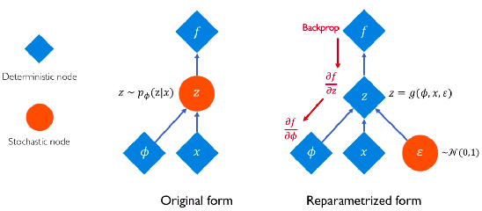
Variational Auto-Encoders
Tasks and Models
Intro to NN
VAE
How do we make the probabilistic components differentiable?!
By using some mathematical manipulations, we move “sampling” operations out of the back-propagation path —> This is called “Re-parametrization”
mean ($μ$)
Direct
Connection
$$InputX$$
$$LatentVectorZ$$
$$Output\overset{˜}{X}$$
$$Z=μ+σ.ϵ,whereϵ∼N(0,1)$$
stdev ($σ$)
Direct
Connection
Sample
$$ϵ∼N(0,1)$$
Encoder
Decoder
Image from https://towardsdatascience.com/reparameterization-trick-126062cfd3c3

Slide 47
Variational Auto-Encoders
Tasks and Models
Intro to NN
VAE
One more issue?! If we train the model as is, then it turns out that the model decides to set the stdev nodes to zero and only pass information through the mean (i.e. the model turns itself back into a deterministic auto-encoder)
To solve this, we add a loss term to our loss function so as to ensure the predicted distributions to be as close to a standard normal distribution as possible
mean ($μ$)
Direct
Connection
$$InputX$$
$$LatentVectorZ$$
$$Output\overset{˜}{X}$$
$$Z=μ+σ.ϵ,whereϵ∼N(0,1)$$
stdev ($σ$)
Direct
Connection
Sample
$$ϵ∼N(0,1)$$
Encoder
Decoder

Slide 48
Tasks and Models
Intro to NN
AE
vs.
VAE
VAE
$$InputX=(x_{0},x_{1},x_{2},...,x_{n-1})$$
$$InputX=(x_{0},x_{1},x_{2},...,x_{n-1})$$
$$LatentDistributionϕ(μ,σ)=(N(μ_{0},σ_{0}),N(μ_{1},σ_{1}))$$
$$LatentVectorZ=(z_{0},z_{1})$$
$$LatentVectorZissampledfromϕ$$
$$2σ_{0}$$
$$z_{1}$$
$$z_{1}$$
$$Z^{(5)}$$
$$Z^{(1)}$$
$$Z^{(4)}$$
$$Z^{(2)}$$
$$Z^{(3)}$$
$$2σ_{1}$$
$$z_{0}$$
$$z_{0}$$
Not Symmetrical
Not centred around origin
“Discreet” Encoding Space
More symmetrical
centred around origin
“Continuous” Encoding Space
$$Z^{(K)}:LatentEncodingofK^{th}Input$$
$$Z^{(K)}:LatentEncodingofK^{th}Input$$
Read this if you’re interested: https://towardsdatascience.com/generating-new-faces-with-variational-autoencoders-d13cfcb5f0a8
Notes:
Finishing remarks
Feed-forward neural nets are not great for sequential data!
FFNs have a fixed scope! They are not great for generating sequences of different lengths
FFNs weigh different time steps the same way, regarding of the sequence their fed
Quite inefficient for long sequences
———-
Talk about how a model is just useful within the observation space (i.e. maximizes likelihood in a given
Observation range —> quite problematic for music
In other words, the model “learns” patterns based on provided examples, but doesn’t know how to extrapolate to places unseen in the musical space

